Slide 1
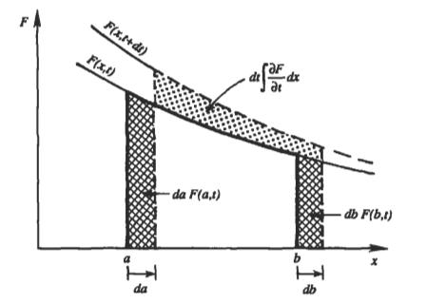

Time derivatives of Volume Integral
In deriving the conservation laws, time derivatives of volume integrals are often appeared
$$\frac{d}{dt}\int_{V}{F(x,t)}dV$$
Where $F(x,t)$ is a tensor of any order, and $V(t)$ is any region, which may be fixed or moved.
$\frac{d}{dt}$ sign has been written because only a function of time remains after performing the integration in space.
General Case
Consider $V(t)$ is neither a fixed volume nor a material volume.
The surface of the volume are moving, but not with the local fluid velocity.
For 1D, Leibniz theorem (detail on Appendix 1) says
$$\frac{d}{dt}\int_{a(t)}^{b(t)}{F(x,t)}dx=\int_{a}^{b}{\frac{∂F}{∂t}}dx+F\left(b,t\right)\frac{db}{dt}−F\left(a,t\right)\frac{da}{dt}$$

Slide 2

Time derivatives of Volume Integral
Generalizing the Leibniz theorem
$$\frac{d}{dt}\int_{V(t)}{F\left(x,t\right)}dV=\int_{V(t)}{\frac{∂F}{∂t}}dV+\int_{A\left(t\right)}{\left(F⊗u_{A}\right)n}dA$$
$$u_{A}≔velocity of the boundary$$
If $Fu_{A}$ is differentiable, by divergence theorem
$$\frac{d}{dt}\int_{V(t)}{F\left(x,t\right)}dV=\int_{V(t)}{\left\{\frac{∂F}{∂t}+div\left(F⊗u_{A}\right)\right\}}dV$$
The surface integral accounts for both inlets and outlets.
Fixed Volume
We have $u_{A}=0$
$$\frac{d}{dt}\int_{V}{F\left(x,t\right)}dV=\int_{V}{\frac{∂F}{∂t}}dV$$
It shows that integration $V$ is not a function of time.

Slide 3
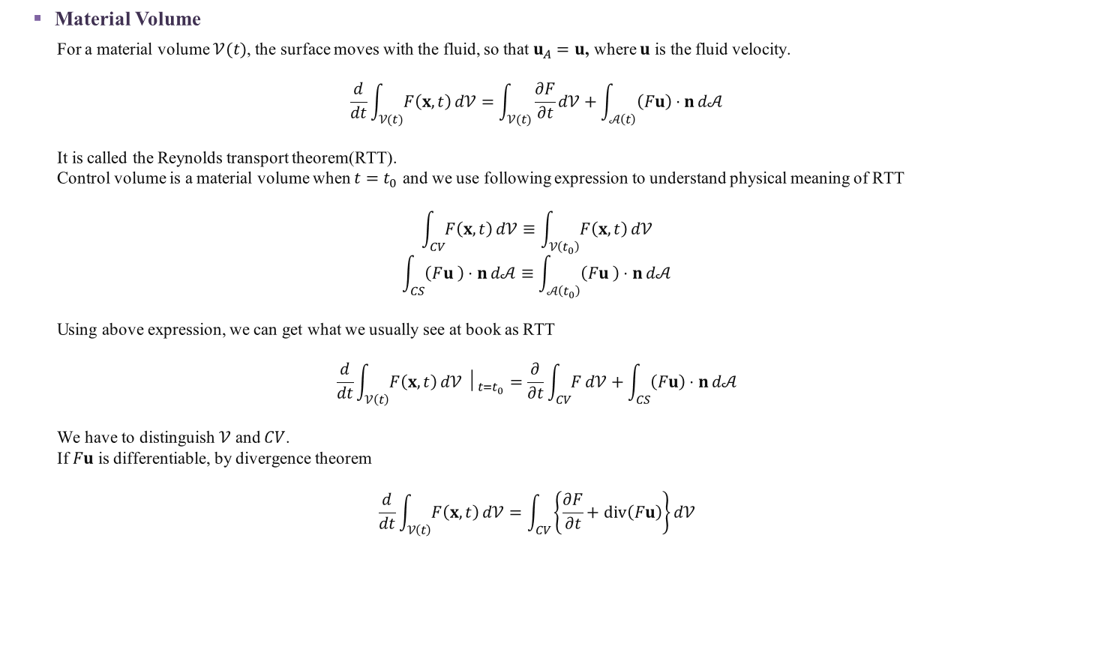
Time derivatives of Volume Integral
Material Volume
For a material volume $𝒱(t)$, the surface moves with the fluid, so that $u_{A}=u$, where $u$ is the fluid velocity.
$$\frac{d}{dt}\int_{𝒱(t)}{F\left(x,t\right)}d𝒱=\int_{𝒱(t)}{\frac{∂F}{∂t}}d𝒱+\int_{𝒜\left(t\right)}{\left(Fu\right)⋅n}d𝒜$$
It is called the Reynolds transport theorem(RTT).
Control volume is a material volume when $t=t_{0}$ and we use following expression to understand physical meaning of RTT
$$\int_{CV}{F\left(x,t\right)}d𝒱≡\int_{𝒱\left(t_{0}\right)}{F\left(x,t\right)}d𝒱$$
$$\int_{CS}{\left(Fu_{ }\right)⋅n}d𝒜≡\int_{𝒜\left(t_{0}\right)}{\left(Fu_{ }\right)⋅n}d𝒜$$
Using above expression, we can get what we usually see at book as RTT
$$\frac{d}{dt}\int_{𝒱\left(t\right)}{F\left(x,t\right)}d𝒱 │_{t=t_{0}}=\frac{∂}{∂t}\int_{CV}{F}d𝒱+\int_{CS}{\left(Fu\right)⋅n}d𝒜$$
We have to distinguish $𝒱$ and $CV$.
If $Fu$ is differentiable, by divergence theorem
$$\frac{d}{dt}\int_{𝒱\left(t\right)}{F\left(x,t\right)}d𝒱=\int_{CV}{\left\{\frac{∂F}{∂t}+div\left(Fu\right)\right\}}d𝒱$$

Slide 4

Antiderivatives
If $\frac{∂}{∂x}F\left(x\right)=f(x)$
Then $F$ be a antiderivative of $f$
Indefinite Integrals
It is notation for antiderivatives.
The notation $\int{f\left(x\right)}dx$ is called an indefinite integral and it represent an entire family of functions
Since $\int{f\left(x\right)}$ is antiderivatives of $f$
$$\frac{d}{dx}\int{f\left(x\right)}dx=f\left(x\right)$$

Slide 5

Appendix 1 Leibniz Integral Rule
Fundamental Theorem of Calculus I
If $f(x,y)$ is continuous on $y∈\left[a,b\right]$, then the function $F(x,y)$ defined by
$$F\left(x,y\right)=\int_{−∞}^{y}{f\left(x,t\right)}dt$$
is continuous on $[a,b]$ and differentiable on $\left(a,b\right)$, and $\frac{∂}{∂y}F\left(x,y\right)=f\left(x,y\right)$.
In other word, $F\left(x,y\right)=\int_{a}^{y}{f\left(x,t\right)}dt$ is $y$-antiderivatives of $f$.
Proof)
Let $y,y+h∈(a,b)$
Then
$$\frac{∂}{∂y}F\left(x,y\right)=\lim_{h→0}{\frac{1}{h}\left(F\left(x,y+h\right)−F\left(x,y\right)\right)}=\lim_{h→0}{\frac{1}{h}\int_{y}^{y+h}{f(x,t)}dt}$$
From Extreme Value Theorem
$$∃u,v∈\left[y,y+h\right] s.t. f\left(x,u\right)≤f\left(x,y\right)≤f\left(x,v\right)$$
When $h≥0$
$$f\left(x,u\right)≤\frac{1}{h}\int_{y}^{y+h}{f\left(x,t\right)}dt≤f\left(x,v\right)$$
Since $h→0$, $u,v→y$
$$\lim_{h→0}\frac{1}{h}\int_{y}^{y+h}{f\left(x,t\right)}dt=f(x,y)$$
By Squeeze Theorem.
In the same way, we can proof $h≤0$ case.

Slide 6

Corollary of Fundamental Theorem of Calculus I
$$\frac{∂}{∂y}\int_{−∞}^{y}{f\left(x,t\right)}dt=f(x,y)$$

Slide 7

Appendix 1 Leibniz Integral Rule
Let $f(x,t)$ be $c_{1}$ continuous on $x∈\left[a,b\right]$ where $a=a\left(t\right) , b=b\left(t\right)$ and both $c_{1}$ continuous on $t∈\left[t_{0},t_{1}\right]$.
Then, for $t∈\left[t_{0},t_{1}\right]$
$$\frac{d}{dt}\int_{a}^{b}{f(x,t)}dt=\int_{a}^{b}{\frac{∂}{∂t}f(x,t)}dt+f\left(b,t\right)\frac{db}{dt}−f\left(a,t\right)\frac{da}{dt}$$
Proof)
Let $F\left(x,t\right)=\int_{0}^{t}{f\left(x,y\right)}dy$
By Fundamental Theorem of Calculus I, $F(x,t)$ is $t$-antiderivatives of $f(x,t)$.
Since $F(x,y)$ is $y$-antiderivatives, by Fundamental Theorem of Calculus II
$$\int_{a}^{b}{f(x,t)}dt=F\left(b,t\right)−F\left(a,t\right)$$
Thus
$$\frac{d}{dt}\int_{a}^{b}{f(x,t)}dt=\frac{∂}{∂b}F\left(b,t\right)\frac{db}{dt}+\frac{∂}{∂t}F\left(x,t\right) −\left(\frac{∂}{∂a}F\left(a,t\right)\frac{da}{dt}+\frac{∂}{∂t}F\left(a,t\right)\right)$$
By corollary of Fundamental Theorem of Calculus I,
$$\frac{∂}{∂b}F\left(b,t\right)=\frac{∂}{∂b}\int_{0}^{b}{f\left(b,y\right)}dy=f\left(b,t\right)$$
$$\frac{∂}{∂a}F\left(a,t\right)=\frac{∂}{∂a}\int_{0}^{a}{f\left(a,t\right)}dt=f\left(a,t\right)$$

